Slide 1

PROJECT PRESENTATION ON
Identification of Hate Speech using
Natural Language Processing and Machine Learning
By
GORLE VINOD KUMAR
Reg. No. 20131f0016
IV Sem. MCA
Under the guidance of
Dr. R.V.V. Murali Krishna
Associate Professor
Head of the Department
Department of Information Technology
DEPARTMENT OF COMPUTER APPLICATIONS
GAYATRI VIDYA PARISHAD COLLEGE OF ENGINEERING (AUTONOMOUS)
VISAKHAPATNAM- 530048.
2020-2022
1

Slide 2
Status of DRC
DRC | Status | Date
DRC-1 | Completed | 29-07-2022
DRC-2 | Completed | 03-09-2022
2

Slide 3
OUTLINE OF THE PRESENTATION
ABSTRACT
LITERATURE REVIEW
OBJECTIVE
INTRODUCTION
METHODOLOGY
DATASET
MODELING OR HARDWARE DIAGRAMS
RESULTS AND ANALYSIS
CONCLUSIONS
REFERENCES
3

Slide 4
ABSTRACT
Hate speech is currently of broad and current interest in the domain of social media. The anonymity and flexibility afforded by the Internet have made it easy for users to communicate aggressively. As the amount of online hate speech is increasing, methods that automatically detect hate speech are very much required.
One of the critical tasks of detection of hate speech is differentiating it from the other context of offensive language. The existing hate speech recognition systems used the Naive Bayes classifier.
In the proposed system, an NLP (Natural Language Processing) technique is used for identifying and extracting keywords that convey hate speech. Based on the machine learning technique logistic regression is popular for probability calculations.
4

Slide 5
Literature Review
Hate speech is complex and multifaceted harmful or offensive content targeting individuals or groups. Existing literature reviews have generally focused on a particular category of hate speech, and to the best of their knowledge. The given paper systematically reviews textual hate speech detection systems and highlights their primary datasets, textual features, and machine learning models. The results of this literature review are integrated with content analysis, resulting in many papers using different methods, algorithms, and technologies to find out hate speech.
[1] M. Bouazizi, H. Watanabe, and T. Ohtsuki, "Hate Speech on Twitter: A Pragmatic Approach to Collect Hateful and Offensive Expressions and Perform Hate Speech Detection," in IEEE Access, vol. 6, pp. 13825-13835, 2018, DOI: 10.1109/ACCESS.2018.2806394
[2] A. Shekhar and M. Venkatesan, "A Bag-of-Phonetic-Codes Model for Cyber-Bullying Detection in Twitter," 2018 International Conference on Current Trends towards Converging Technologies (ICCTCT), 2018, pp. 1-7, DOI: 10.1109/ICCTCT.2018.8550938.
5

Slide 6
OBJECTIVE
The main objective of the work is :
Hate Speech detection using Natural Language Processing and Machine Learning algorithms.
Classify tweets into two classes based on sentiment analysis.
6

Slide 7
INTRODUCTION
Hate Speech :
Hate speech is speech that attacks a person or group on the basis of attributes such as race religion, ethnic origin, national origin, gender, disability, or sexual orientation.
In the face of the popularization of social media such as Facebook, Twitter, Instagram, and Tik Tok, communication between people has become faster and easier. In these communication mechanisms, people can express their feelings, criticism, opinions, achievements, etc.
The big problem with this relies on the fact that the offense is presented to individuals or groups and this can be potentially harmful to them.
7

Slide 8
INTRODUCTION
Natural Language Processing:
NLP is a field in machine learning with the ability of a computer to understand, analyze, manipulate, and potentially generate human language.
Its goal is to build systems that can make sense of text and automatically perform tasks like translation, spell check, or topic classification
NLP in Real Life Example
Information Retrieval Google finds relevant and similar results
Machine Translation Google Translate translates language from one language to another.
Text Simplification Simplifies the meaning of sentences.
Sentiment Analysis Hater News gives us the sentiment of the user.
Text Summarization It gives a summary of sentences.
Spam Filter Gmail filters spam emails separately.
Auto-Predict Google Search predicts user search results.
Natural Language Toolkit(NLTK): NLTK is a popular open-source package in Python. Rather than building all tools from scratch, NLTK provides all common NLP Tasks.
8

Slide 9
METHODOLOGY
METHODOLOGY
METHODOLOGY
9

Slide 10
EXISTING SYSTEM
One of the critical tasks of automatic detection of hate speech is differentiating it from the other context of offensive language. The existing hate speech recognition systems used the Naive Bayes classifier.
As the existing model did not use NLP techniques such as Semantic analysis, sentiment analysis, and unigram feature, they could not achieve the desired accuracy.
10

Slide 11
PROPOSED SYSTEM
The proposed system aims to increase the accuracy of hate speech prediction using Natural Language Processing and Logistic Regression techniques.
11

Slide 12
SOFTWARE AND HARDWARE REQUIREMENTS
Software Requirements:
Operating system : Windows XP/7/10
Software : Python 3.6 or high version
IDE : PyCharm.
Framework : Flask
Hardware Requirements:
RAM : 8 GB
Hard disk : More than 500 GB
Processor : Intel 5th generation or high.
12

Slide 13
DATASET DESCRIPTION
Text file is used for detecting Hate Speech
Size of the dataset:-7.53 MB
The dataset contains 40740 entries.
All 40740 entries are used.
The Dataset contains 10 fields,
Training Data: 80%
Testing Data:20%
Dataset is Collected from the reference of the Kaggle website
https://www.kaggle.com/code/tarushi89/hate-speech-data-analysis/data
2020-12-31-DynamicallyGeneratedHateDataset-entries-v0.1.csv
13

Slide 14
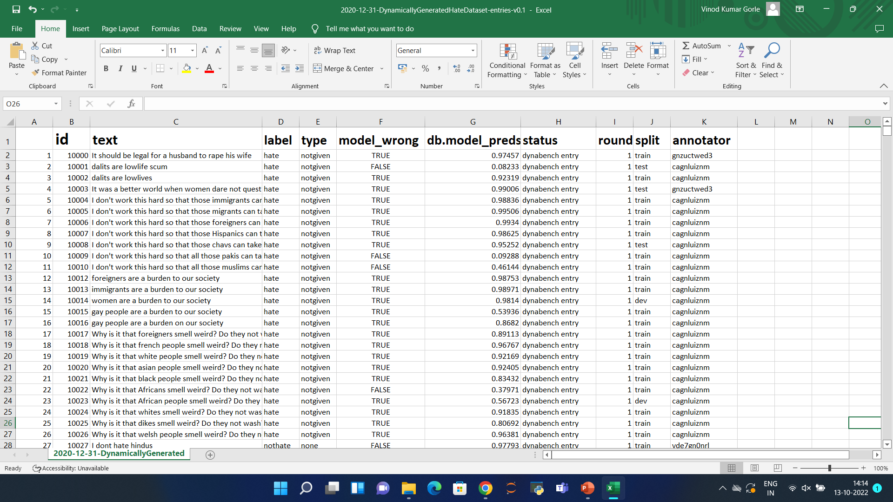
14

Slide 15
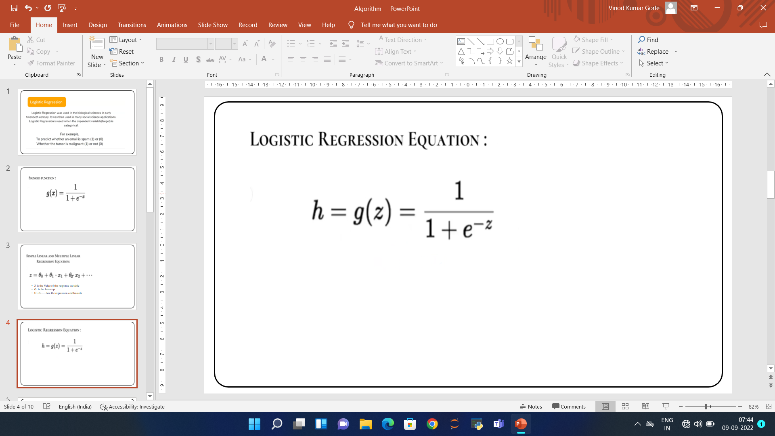
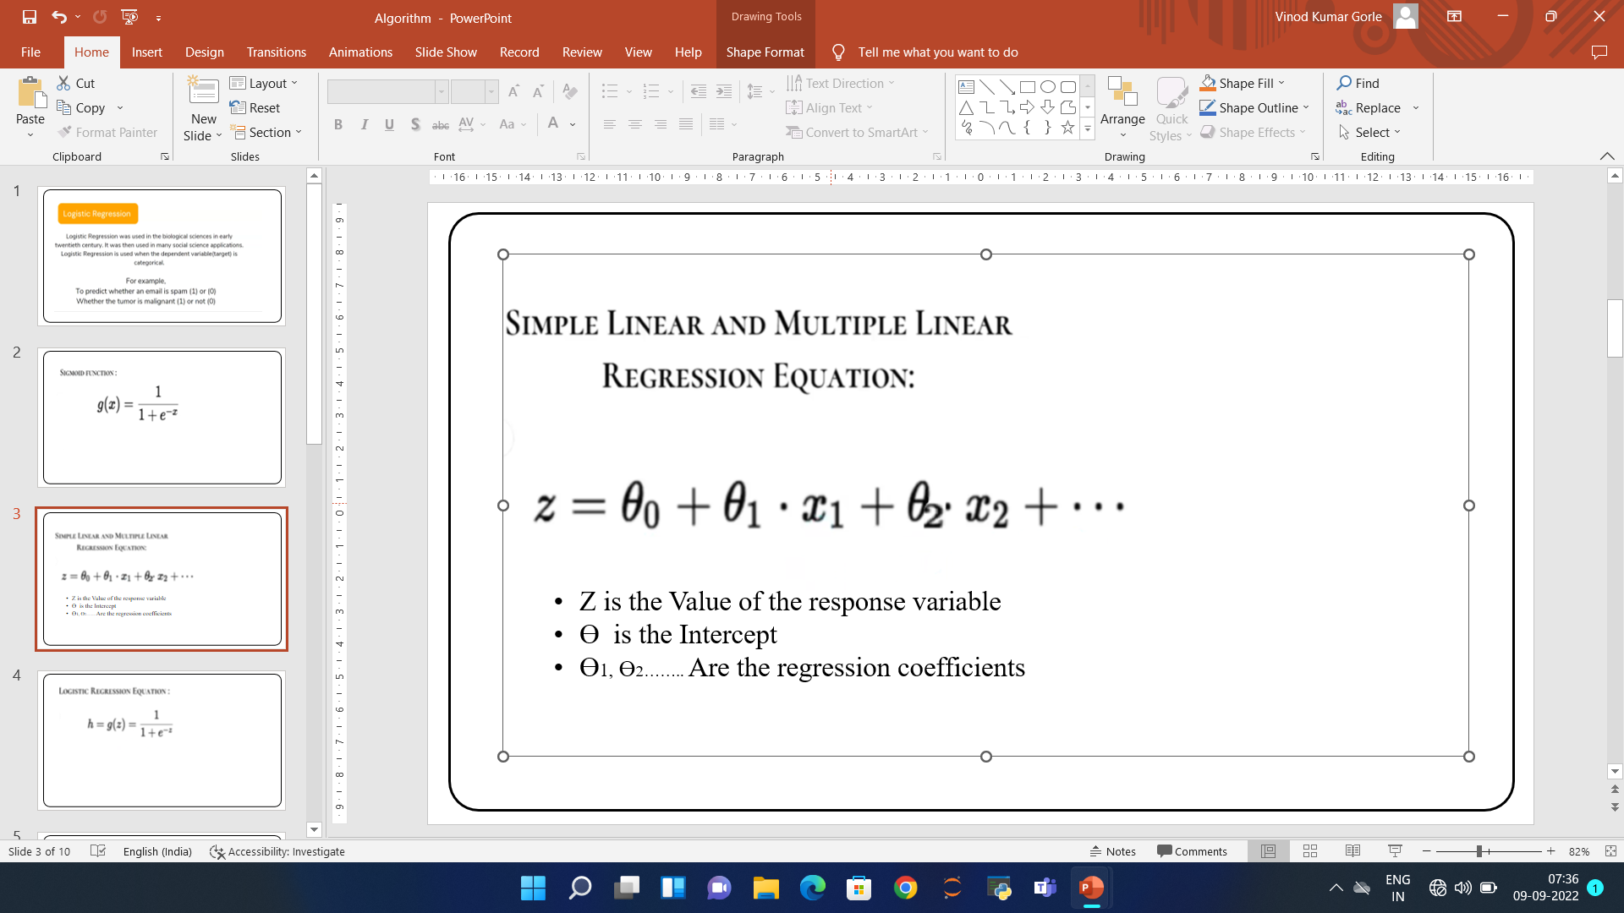
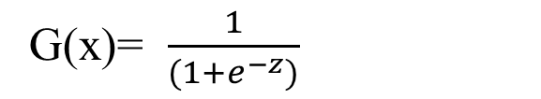
Algorithm
Logistic Regression :
Logistic Regression was used in the early twentieth century. It was then used in many social science applications. Logistic Regression is used when the dependent variable (target) is categorical.
For example,
To predict whether an email is a spam (1) or not (0)
Whether the tumor is malignant (1) or not (0)
G(x)= $\frac{1}{(1+e^{−z})}$
Here
Z is the Value of the response variable
Ɵ is the Intercept
x1, x2…….. Are the regression coefficients
15

Slide 16
The algorithm in Logistic Regression:
Step:-1
Data Pre-processing step
Step:-2
Fitting Logistic Regression to the Training set
Step:-3
Predicting the test result
Step:-4
Test accuracy of the result
Step:-5
Visualizing the test set result.
16

Slide 17

Graph :
Here
The x-axis shows the values of the predictor variable
The y-axis displays the predicted probability
17

Slide 18
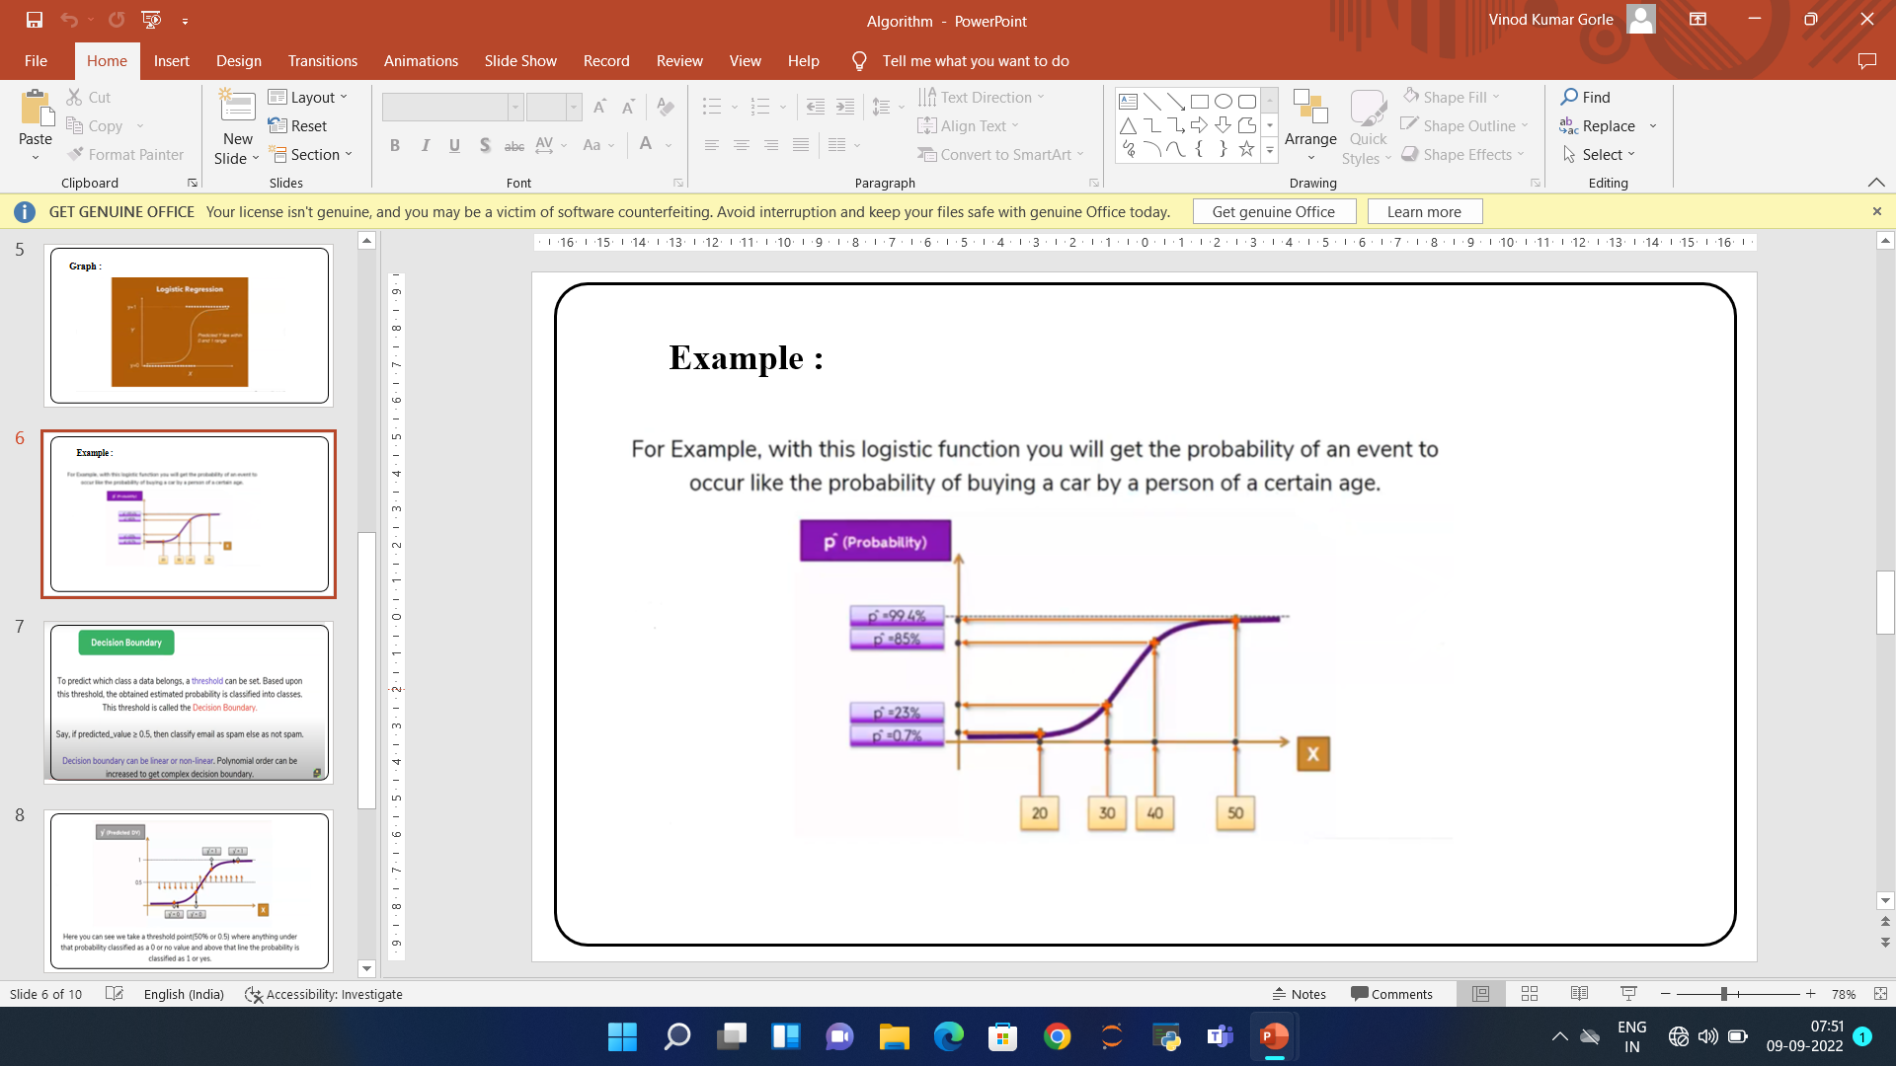
Example :
For Example, with this Logistic function, you will get the probability of an event to occur like the probability of buying a car by a person of a certain age
y
Here
X= Age
Y= Prediction Values
18

Slide 19
Naive Bayes Classifier Algorithm :
Naive Bayes algorithm is a supervised learning algorithm, which is based on the Bayes theorem and used for solving classification problems.
It is mainly used in text classification that includes a high-dimensional training dataset.
It is a probabilistic classifier, which means it predicts on the basis of the probability of an object.
Some popular examples of the Naïve Bayes Algorithm are spam filtration, Sentimental analysis, and classifying articles.
Bayes' Theorem:
Bayes' theorem is also known as Bayes' Rule or Bayes' law, which is used to determine the probability of a hypothesis with prior knowledge.
19

Slide 20
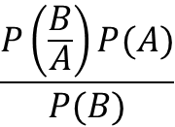
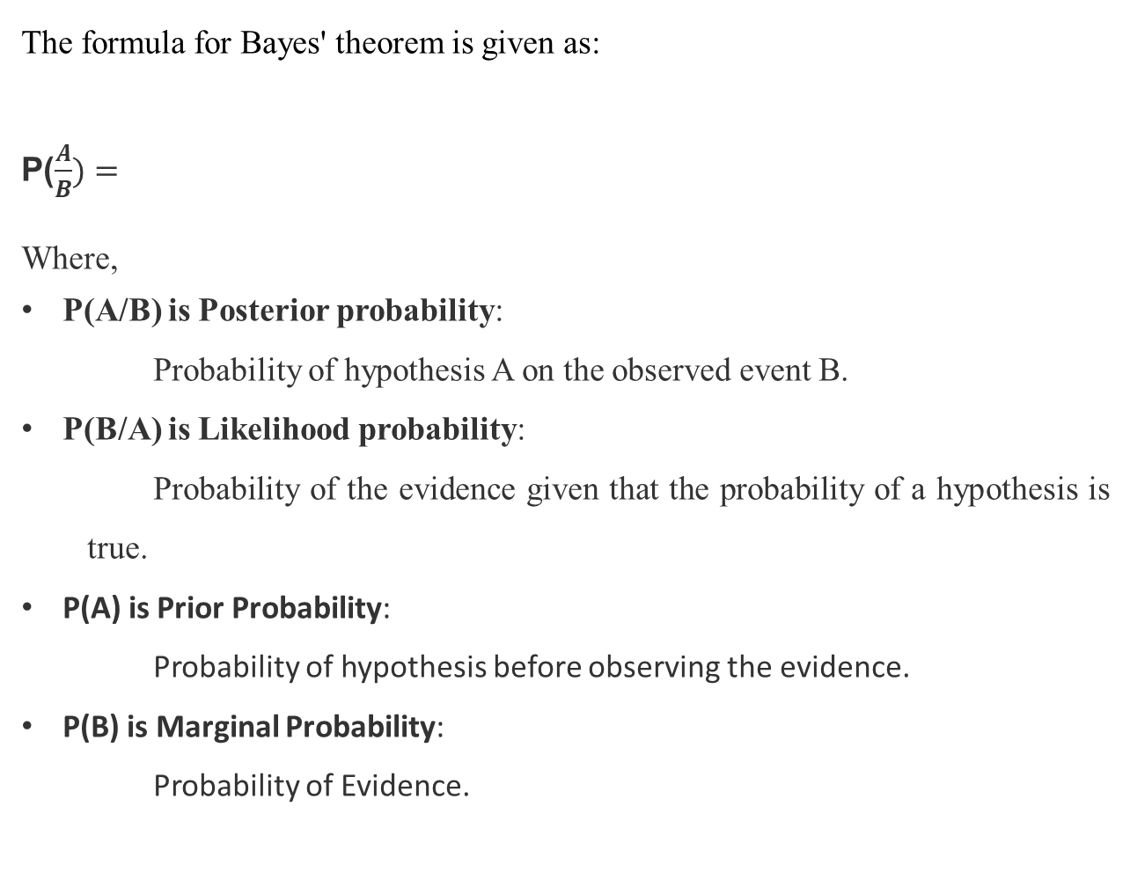
The formula for Bayes' theorem is given as:
P($\frac{A}{B})=$
Where,
P(A/B) is Posterior probability:
Probability of hypothesis A on the observed event B.
P(B/A) is Likelihood probability:
Probability of the evidence given that the probability of a hypothesis is true.
P(A) is Prior Probability:
Probability of hypothesis before observing the evidence.
P(B) is Marginal Probability:
Probability of Evidence.
$$\frac{P\left(\frac{B}{A}\right)P(A)}{P(B)}$$
20

Slide 21
Working of Naïve Bayes' Classifier:
Step:-1
Data Pre-processing step
Step:-2
Fitting Naive Bayes to the Training set
Step:-3
Predicting the test result
Step:-4
Test accuracy of the result
Step:-5
Visualizing the test set result.
21

Slide 22
METHODOLOGY
Semantic Analysis:
Semantic analysis is a subfield of NLP and Machine learning that helps to explain the grammar part of the comment. It included how the user uses exclamation marks, question marks, and other such punctuations.
Sentiment Analysis:
Sentiment analysis (or opinion mining) is a Natural language processing (NLP) technique used to determine whether data is positive, or negative. Sentiment analysis is often performed on textual data to help businesses monitor brand and product sentiment in customer feedback, and understand customer needs.
Unigram Feature:
In Unigram we assume that the occurrence of each word is independent of its previous word.
In natural language processing, an n-gram is a sequence of n words. For example, “statistics” is a unigram (n = 1), “machine learning” is a bigram (n = 2), “natural language processing” is a trigram (n = 3), and so on
22

Slide 23
MODELING DIAGRAMS
MODELING DIAGRAMS
Modeling Diagrams
23
Notes:
DATA FLOW DIAGRAM

Slide 24
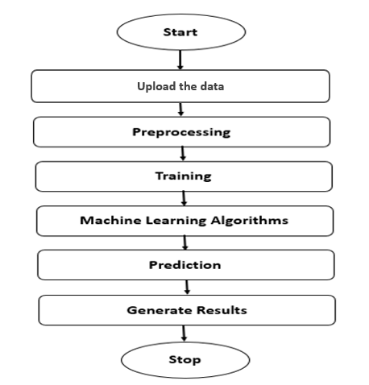
Block Diagram
24

Slide 25
UML DIAGRAMS
25

Slide 26
USE CASE DIAGRAM
Admin
26

Slide 27
SEQUENCE DIAGRAM
27

Slide 28
CLASS DIAGRAM
_
_
_
_
28

Slide 29
ACTIVITY DIAGRAM
29

Slide 30
Output Screens
RESULTS AND ANALYSIS
30

Slide 31

Home Page:
31

Slide 32
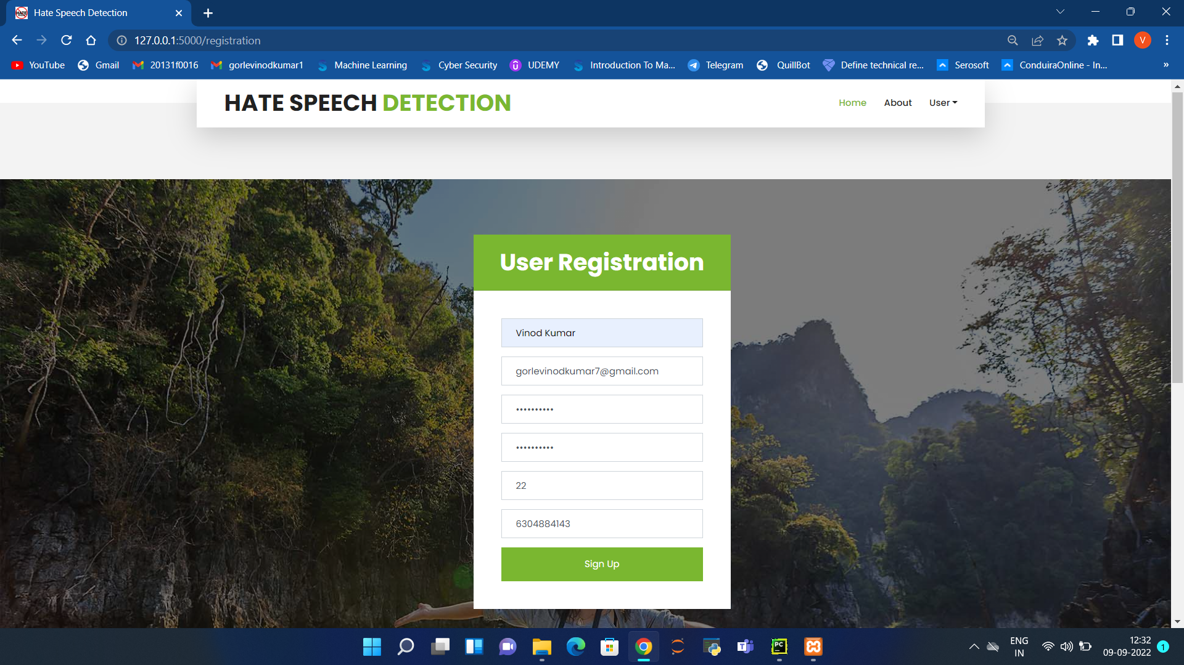
Registration :
32

Slide 33
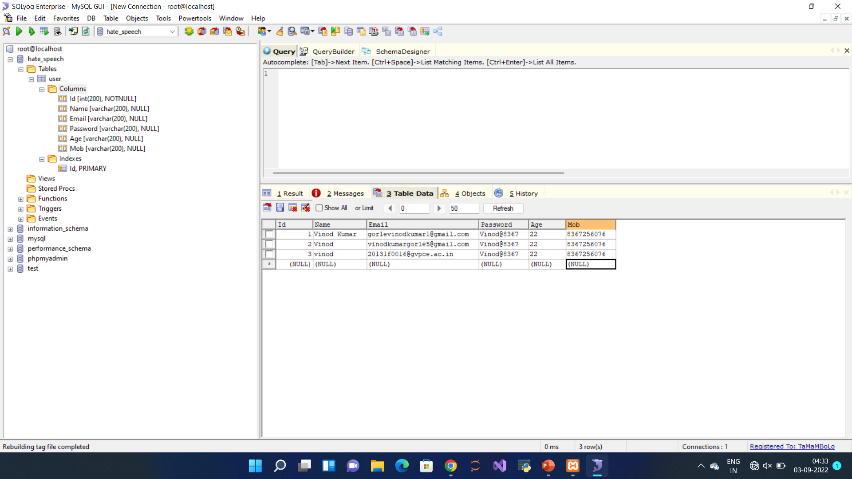
Database
33

Slide 34
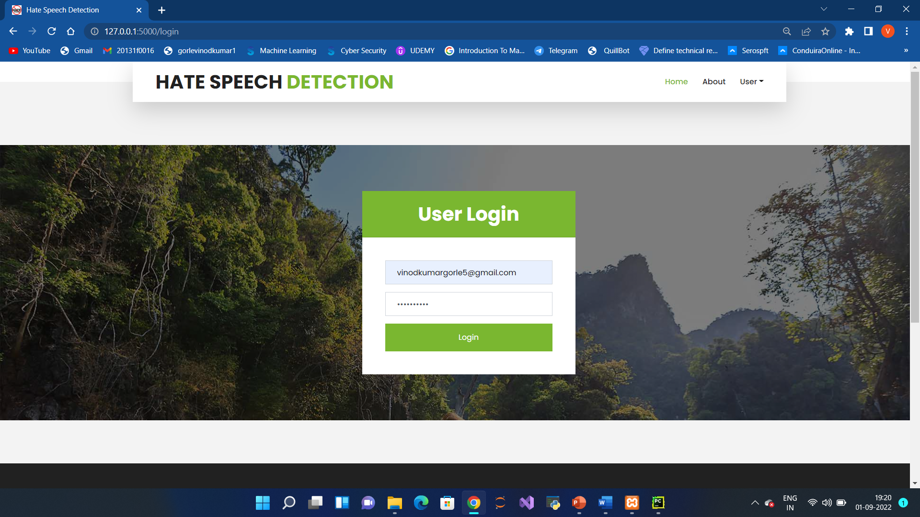
Login:
34

Slide 35

35

Slide 36
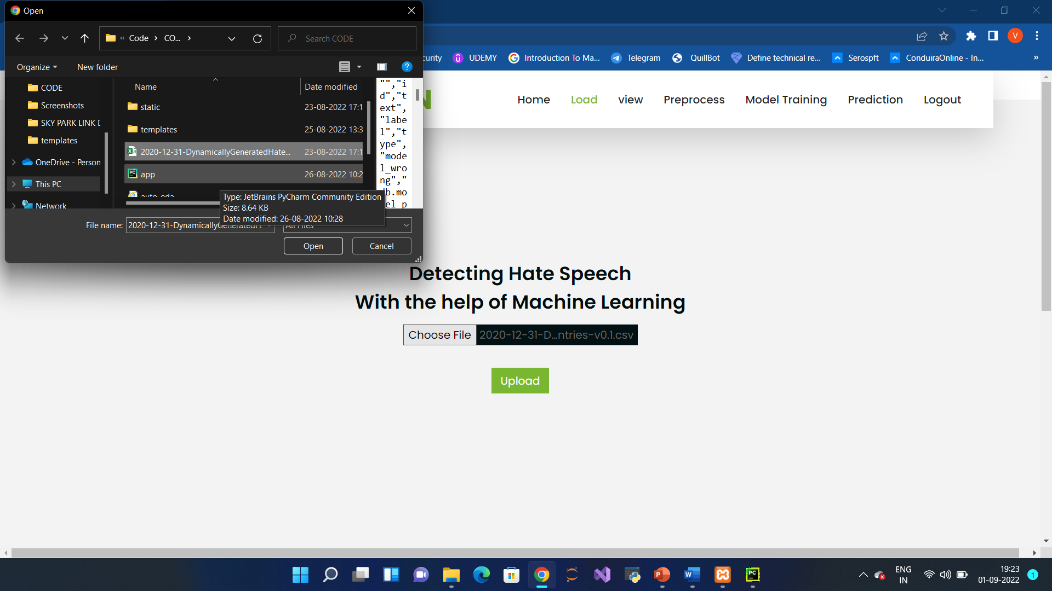
Load:
In the load page, users can load the dataset.
36

Slide 37
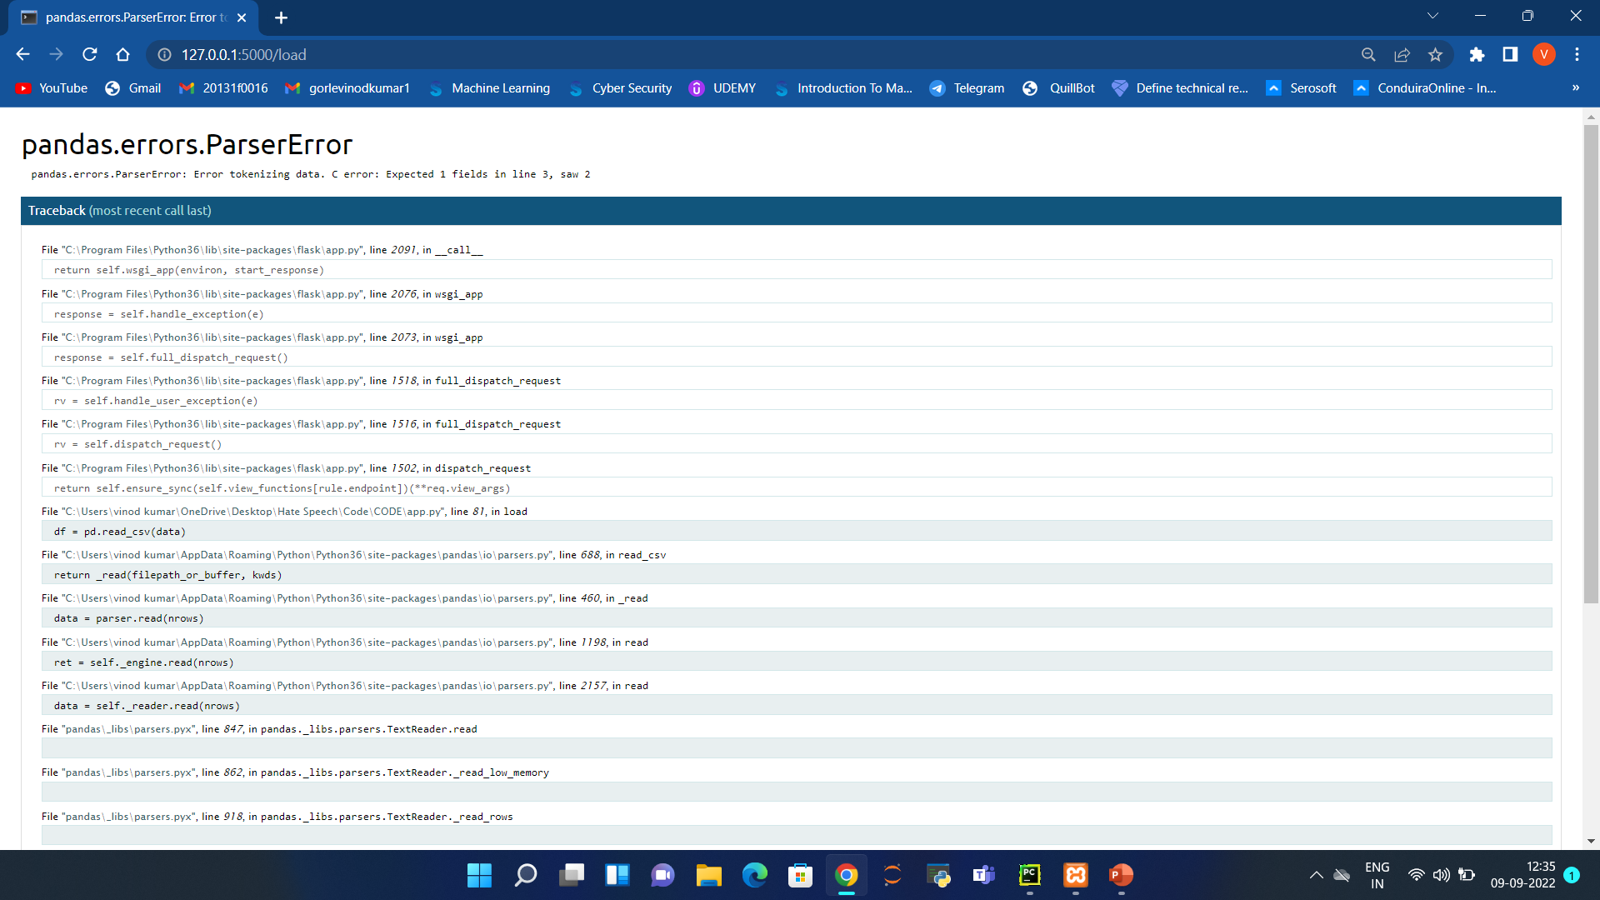
When a user uploads an Invalid Format of Dataset this Error has occurred
37

Slide 38
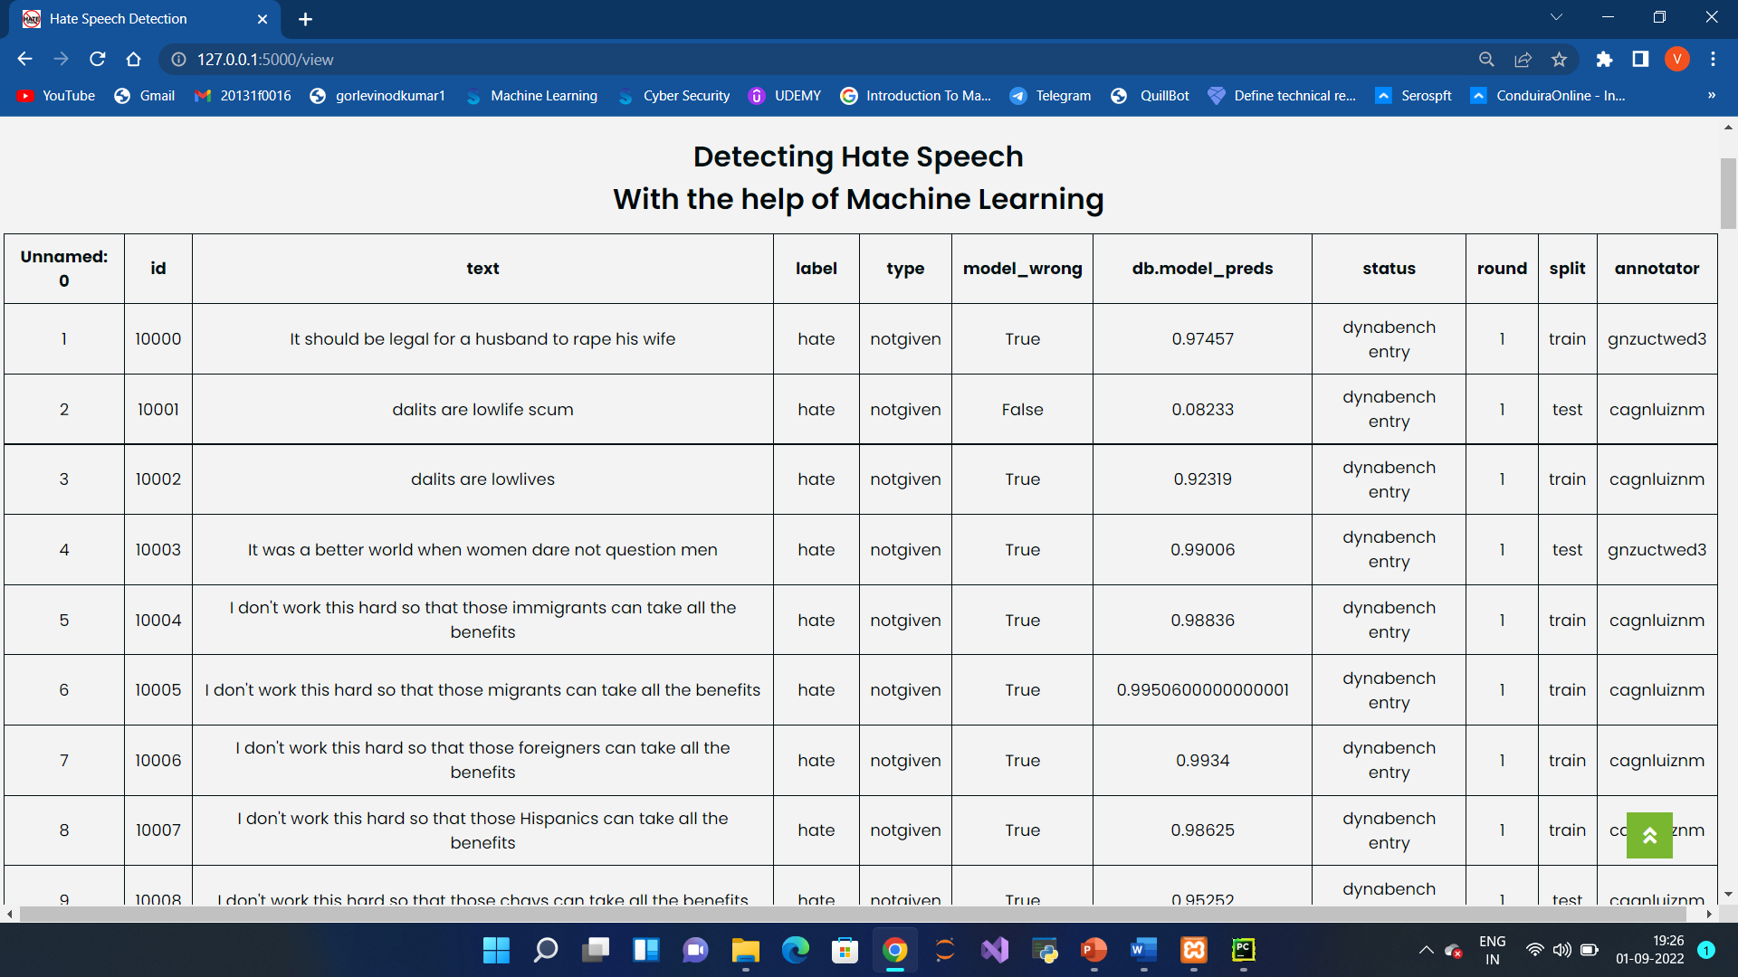
DATASET
Here user can see the uploaded data set.
38

Slide 39
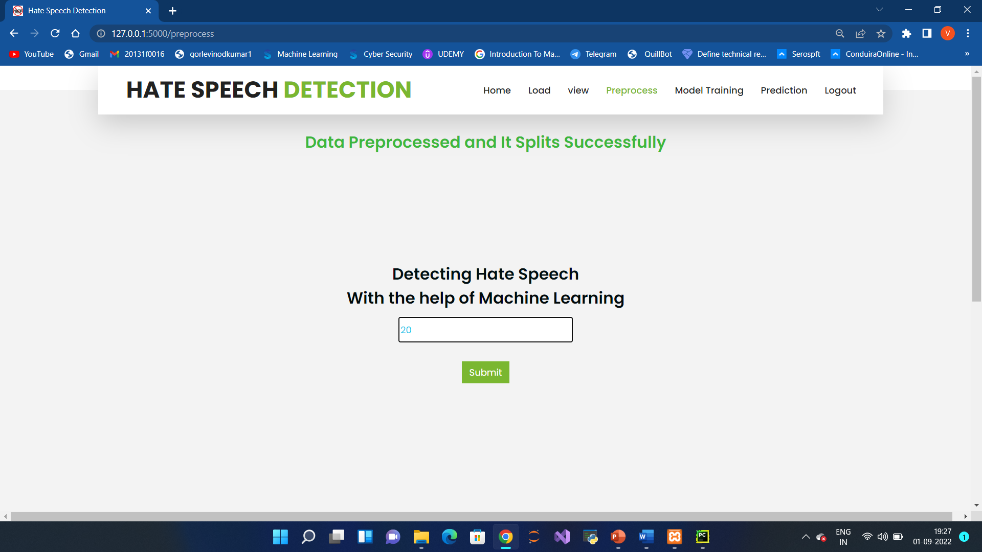
Pre-process:
Here user can prepare our data in such a way that our system can understand means we will make our data noise free over here.
39

Slide 40
Model:
Here user train our data using these two algorithms.
40

Slide 41
41

Slide 42
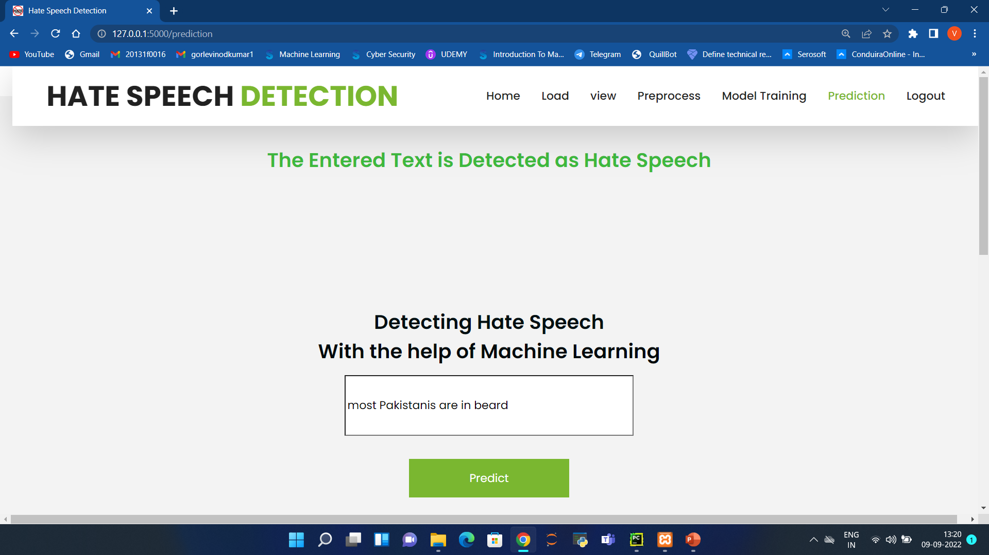
Prediction:
This page show the detection result of the personality prediction data.
42

Slide 43
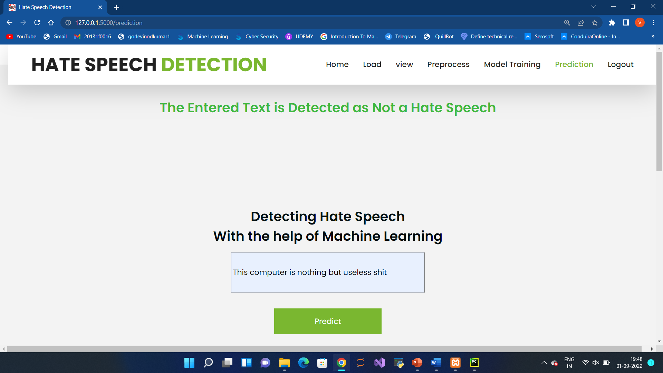
43

Slide 44
TEST CASES:
Test case ID | Testcase Name | Expected Output | Observed Output | Status
T-01 | Login with Registered details or not | Homepage should be displayed | Homepage displayed | Pass
T-02 | User giving input by clicking on Upload | Data should be upload | Data uploaded | Pass
T-03 | Predicting whether the text is Hate speech or not | Hate speech is Detected | Hate speech is detected | Pass
T-04 | Database Storing Details | Registered and Login details should be stored in Database | Registered and Login details are stored in the Database | Pass
44

Slide 45
COMPARISION BETWEEN EXISTING SYSTEM AND PROPOSED SYSTEM
Sl.no | Existing System | Proposed System
1) | Naïve bayes Algorithm. | Logistic Regression Algorithm.
2) | Here we didn't use NLP techniques | NLP techniques are used.
3) | The Accuracy is 65.783 | The Accuracy is 94.543
45

Slide 46
CONCLUSION
Hate speech is very harmful and needs to be dealt with seriously for its elimination. It does not only lead to real-life conflicts but also affects the mental health of a person. This system briefly explained the various features of Natural Language Processing that were used. Here, Logistic regression and Naïve Bayes classifiers were implemented, and selected the one with the maximum accuracy. One of the use cases for future work in this system could be the detection of long phrases or sentences.
46

Slide 47
REFERENCES
[1] Graeme Foux. Consumer-generated media: Get your customers involved. Brand Strategy, 8(202):38–39, 2006.J. Clerk Maxwell, A Treatise on Electricity and Magnetism, 3rd ed., vol. 2. ,1892, pp.68– 73.
[2] https://www.facebook.com/communitystandards/
[3] https://help.twitter.com/en/forms/safety-and-sensitive-content/abuse
[4] M. Bouazizi, H. Watanabe, and T. Ohtsuki, "Hate Speech on Twitter: A Pragmatic Approach to Collect Hateful and Offensive Expressions and Perform Hate Speech Detection," in IEEE Access, vol. 6, pp. 13825-13835, 2018, DOI: 10.1109/ACCESS.2018.2806394.
[5] A. Shekhar and M. Venkatesan, "A Bag-of-Phonetic-Codes Model for Cyber-Bullying Detection in Twitter," 2018 International Conference on Current Trends towards Converging Technologies (ICCTCT), 2018, pp. 1-7, DOI: 10.1109/ICCTCT.2018.8550938.
[6] M. Gomes, R. Martins, J. J. Almeida, P. Henriques, and P. Novais, "Hate Speech Classification in Social Media Using Emotional Analysis," 2018 7th Brazilian Conference on Intelligent Systems (BRACIS), 2018, pp. 61-66, DOI: 10.1109/BRACIS.2018.00019.
47

Slide 48
THANK YOU
48

